Slide 1


What’s in a GHG?
Pulling back the curtains on TDPUD’s efforts in Greenhouse Gas Mitigation

Slide 2

Background & Context
Both the Regulatory and Public spheres have high expectation for utility providers – and rightfully so!
Mission to provide reliable, high quality services while managing District resources in a safe, open, responsible, and environmentally sound manner at the lowest practical cost.
Data driven and transparent approaches are critical to success.
Planning must start with clear, well defined, objectives translated into quantifiable metrics.
Notes:
LED Lighting Image Src: https://www.lampsplus.com/ideas-and-advice/wp-content/uploads/2020/09/LED_Light_Bulbs_Image-1024x681.jpg
Energy Star Appliances Image Src: https://www.mlecmn.net/sites/default/files/inline-images/Image_Res_Appliances_1.png

Slide 3
Background & Context
Greenhouse Gas Inventory: Designed to provide critical insight into how TDPUD will make meaningful, cost effective, progress towards greenhouse gas reduction through energy purchases, conservation, and day-to-day operations.
Residential Saturation Survey: Collected information on home characteristics and equipment, as well as use of and interest in electric vehicles, space heating, water heating, and cooking equipment to inform customer program design.
Integrated Resource Plan: Developed a planning framework that enables direct comparison/prioritization of demand-side and supply-side resources (e.g. optimizing a path to cost effectively achieve GHG reductions)

Slide 4
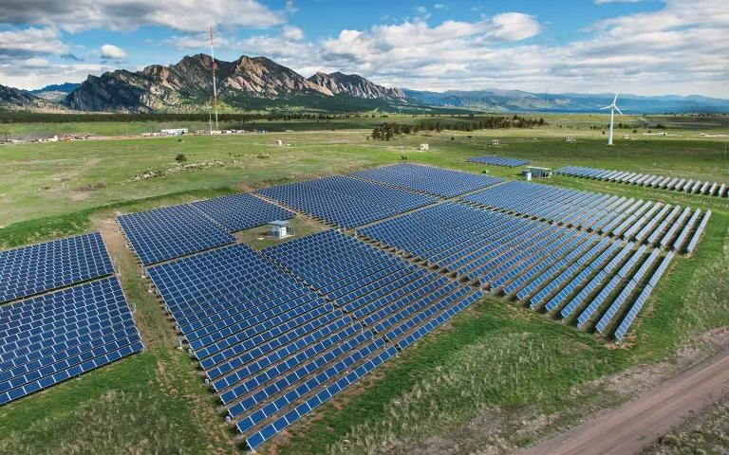
GREENHOUSE GAS SURVEY
Initial GHG inventory done in 2012 (using 2008 as baseline)
Evolving sustainability programs
Net Carbon Reduction Strategic Initiative
TDPUD wants to make meaningful progress towards GHG mitigation through cost-effective energy purchase, beneficial investments into conservation, and data-driven innovation.
Notes:
Image src: https://www.efficiencyvermont.com/Media/Default/blog/HowTo/EVT-Brand-2021-COVER-IMAGE.jpg?width=1120&quality=80&format=jpg

Slide 5
GREENHOUSE GAS SURVEY
Fundamental difference between the objectives underlying the engineering assumptions and reporting standards established by statewide programs and those applied in this GHG inventory
CARB Mandatory GHG Reporting
Industry Standard GHG Inventory Reporting
Renewable Portfolio Standard
Notes:
Image src: https://www.efficiencyvermont.com/Media/Default/blog/HowTo/EVT-Brand-2021-COVER-IMAGE.jpg?width=1120&quality=80&format=jpg

Slide 6
GREENHOUSE GAS SURVEY
Summary of Emissions Intensity Factors by Generation Source
 | Generation Technology | [gCO2e/kWh] |  |  |  | Total
 |  | Upstream | On-Going |  | Downstream
 |  |  | Combustion | non-combustion
Renewable | Photovoltaic (All Technologies) | 28.0 | 0.0 | 10.0 | 5.0 | 43.4
 | Concentrating Solar Power (Trough and Tower) | 19.7 | 0.0 | 10.0 | 0.5 | 28.0
 | Geothermal (All Technologies) | 15.3 | 0.0 | 6.9 | 0.1 | 36.7
 | Hydropower (All Technologies) | 6.2 | 0.0 | 1.9 | 0.0 | 20.5
 | Wind (All Technologies) | 11.8 | 0.0 | 0.7 | 0.3 | 13.0
Non-renewable | Nuclear - Light Water Reactor (LWR) | 2.0 | 0.0 | 11.7 | 0.7 | 13.0
 | Natural Gas - Conventional Gas | 0.8 | 389.0 | 71.0 | 0.0 | 486.0
 | Coal (All Technologies) | 2.5 | 1,010.0 | 10.0 | 2.5 | 1,001.0
Storage | Pumped-Storage Hydropower | 3.0 | 0.0 | 1.8 | 0.1 | 7.4
 | Li-Ion Battery Storage | 31.5 | 0.0 | NR | 3.4 | 32.9
 | Hydrogen Storage | 26.7 | 0.0 | 2.5 | 1.9 | 37.9
Notes:
Image src: https://www.efficiencyvermont.com/Media/Default/blog/HowTo/EVT-Brand-2021-COVER-IMAGE.jpg?width=1120&quality=80&format=jpg

Slide 7
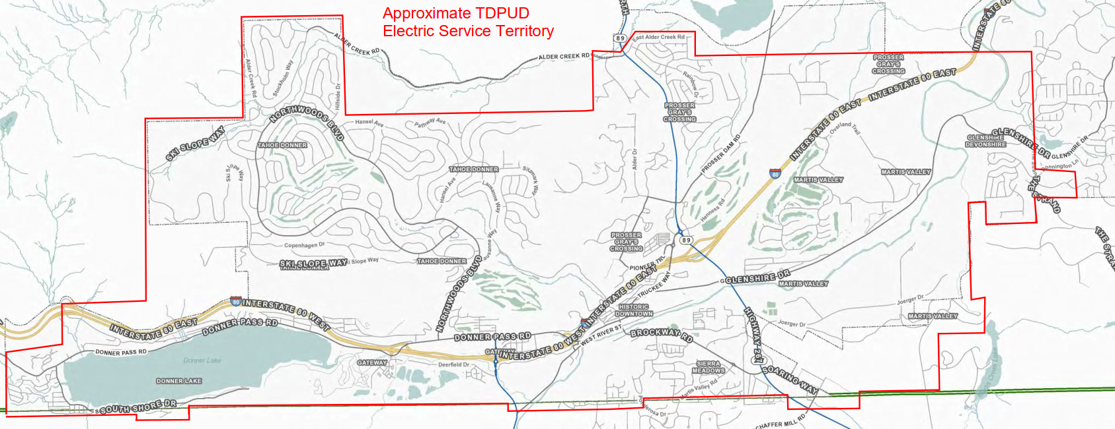
GREENHOUSE GAS SURVEY
Organizational Boundary:
The equity share perspective provides an accounting of activities wholly and partially owned by the district – with emissions being accounted according to the organization’s ownership share.
Operations and Maintenance (O&M) for the District’s electric Transmission & Distribution (T&D) System
O&M for the District’s water pumping, treatment, and distribution infrastructure
Headquarter building O&M
Energy resources consumed by District stationary facilities (and mobile equipment)
Energy resource consumption, O&M, and embedded product emissions from several electric generation facilities which include:
  Horse Butte Wind Farm (26% Share),
  Veyo Heat Recovery Project (23% Share), and
  Nebo Power Station (3% Share)
Notes:
Image src: https://www.efficiencyvermont.com/Media/Default/blog/HowTo/EVT-Brand-2021-COVER-IMAGE.jpg?width=1120&quality=80&format=jpg

Slide 8
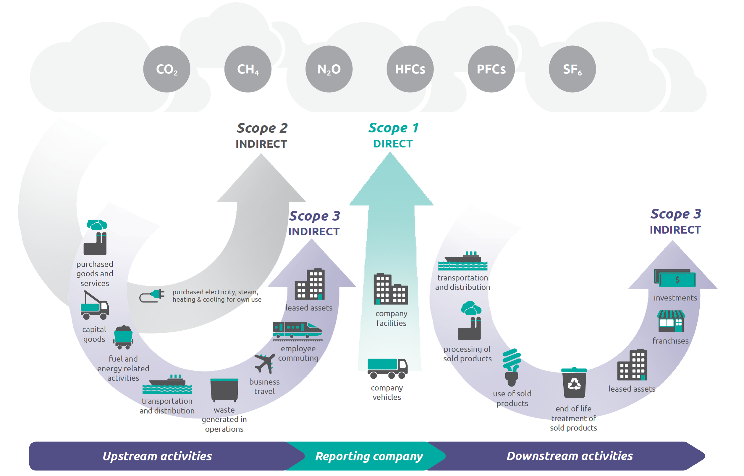
GREENHOUSE GAS SURVEY
GRPv3 establishes a comprehensive accounting framework for categorizing direct and indirect anthropogenic emissions
* emissions can only be meaningfully aggregated across separate organizations within a particular scope
Notes:
Image src: https://www.efficiencyvermont.com/Media/Default/blog/HowTo/EVT-Brand-2021-COVER-IMAGE.jpg?width=1120&quality=80&format=jpg

Slide 9
GREENHOUSE GAS SURVEY
Inventory Results:
Establishes a “Baseline”
Biggest local (direct) bucket is transportation related
Incremental improvements to portfolio will have significant impacts to overall emissions
Conservation = GHG reductions!
Scope | Component | Component Emissions [Tons CO₂e] | Scope Emissions [Tons CO₂e]
1 | Transport | 475 | 9,394
 | Building | 155
 | Generation* | 8,763
2 | Electricity Consumed | 235 | 239
 | Transmission Losses | 3.50
3 | Employee Commutes | 337 | 33,516
 | Electricity Sold | 32,701
 | Wastewater (water sold) | 478
* Including District Equity Component
Notes:
Image src: https://www.efficiencyvermont.com/Media/Default/blog/HowTo/EVT-Brand-2021-COVER-IMAGE.jpg?width=1120&quality=80&format=jpg

Slide 10
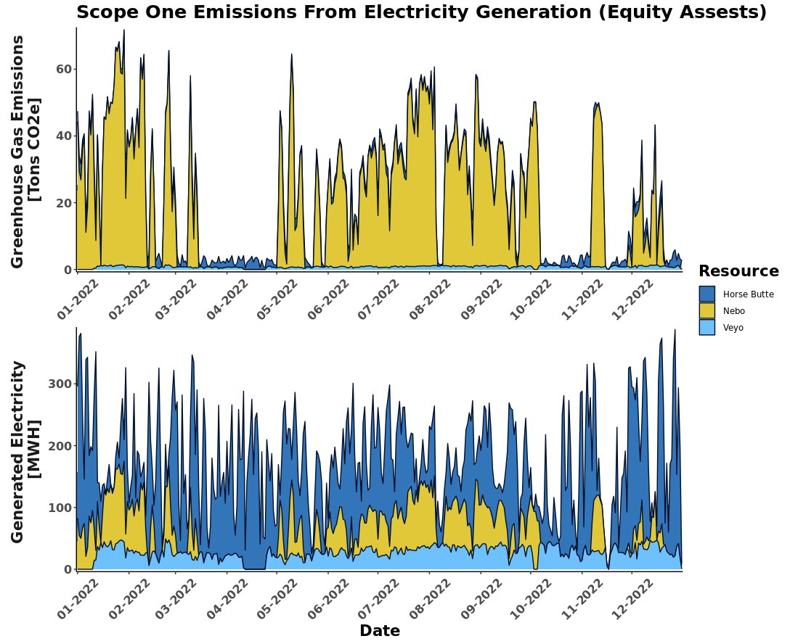
GREENHOUSE GAS SURVEY
While the emissions from Horse Butte and Veyo are non-zero, the major contributor to overall emissions comes from the Nebo power plant (shown in yellow).
Notes:
Image src: https://www.efficiencyvermont.com/Media/Default/blog/HowTo/EVT-Brand-2021-COVER-IMAGE.jpg?width=1120&quality=80&format=jpg

Slide 11
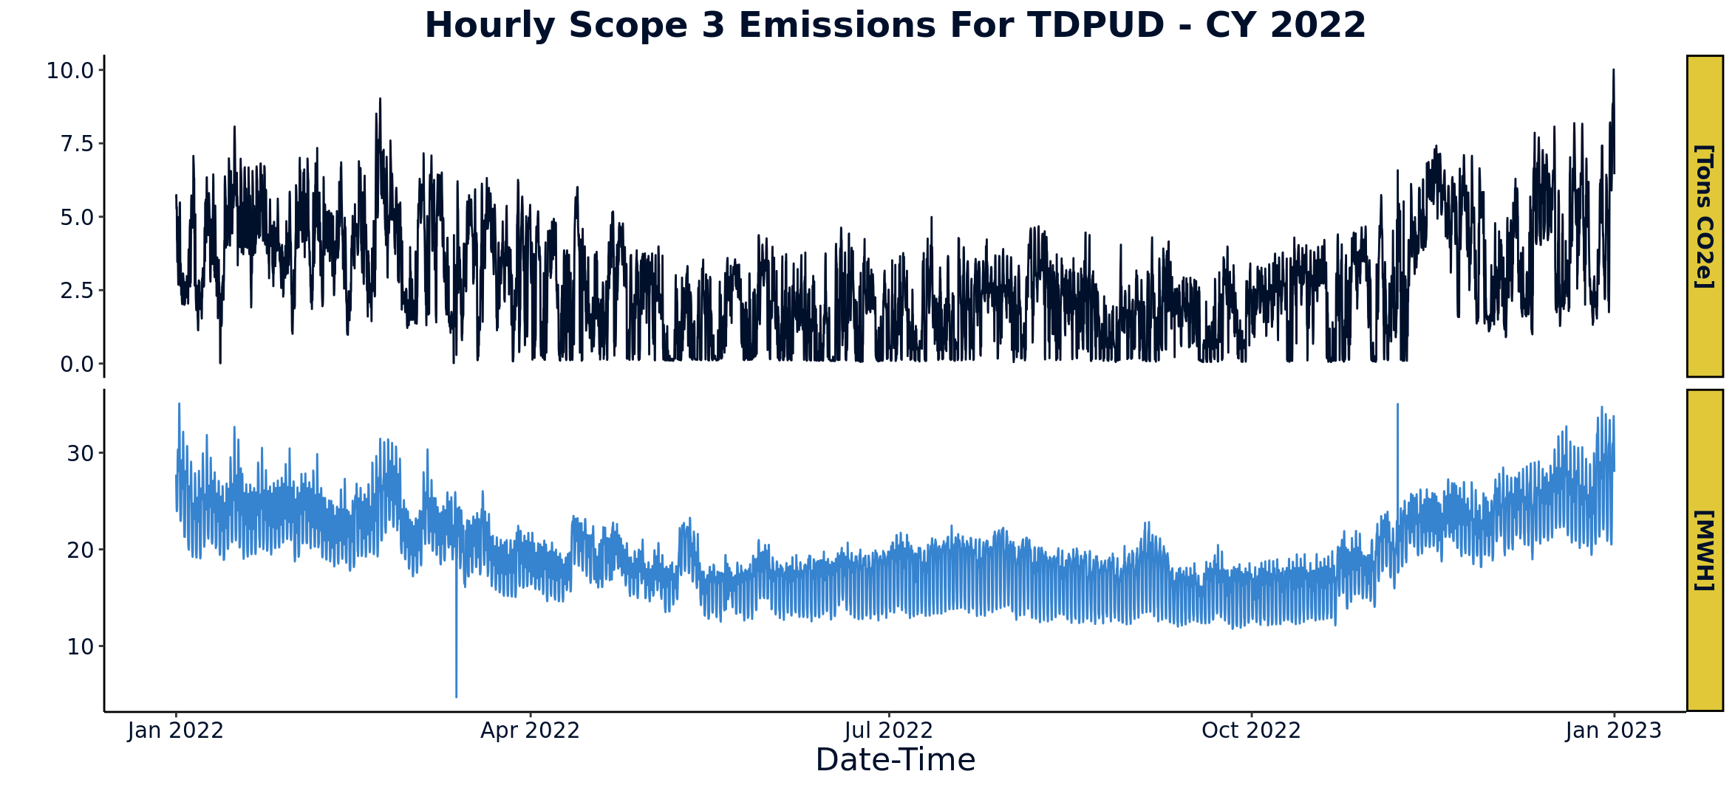
GREENHOUSE GAS SURVEY
At a general level, emissions are proportional to electricity use which reaches its peak in the winter months. However, it is also sensitive to the specific mix of generation resources at a given moment
Notes:
Image src: https://www.efficiencyvermont.com/Media/Default/blog/HowTo/EVT-Brand-2021-COVER-IMAGE.jpg?width=1120&quality=80&format=jpg

Slide 12
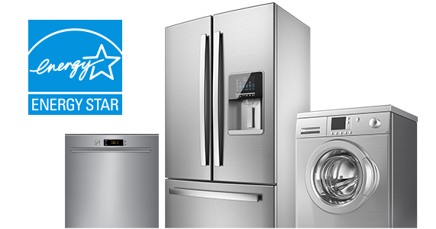

Residential Energy Use Survey
TDPUD has a long (and successful) history of conservation!
Programs need to find an appropriate balance between electrification and conservation
Programs need to remain relevant to evolving markets and economic conditions (including updates to codes and standards!)
Collected information on home characteristics and equipment, as well as use of and interest in electric vehicles, space heating, water heating, and cooking equipment.
Notes:
Image src: https://www.efficiencyvermont.com/Media/Default/blog/HowTo/EVT-Brand-2021-COVER-IMAGE.jpg?width=1120&quality=80&format=jpg

Slide 13
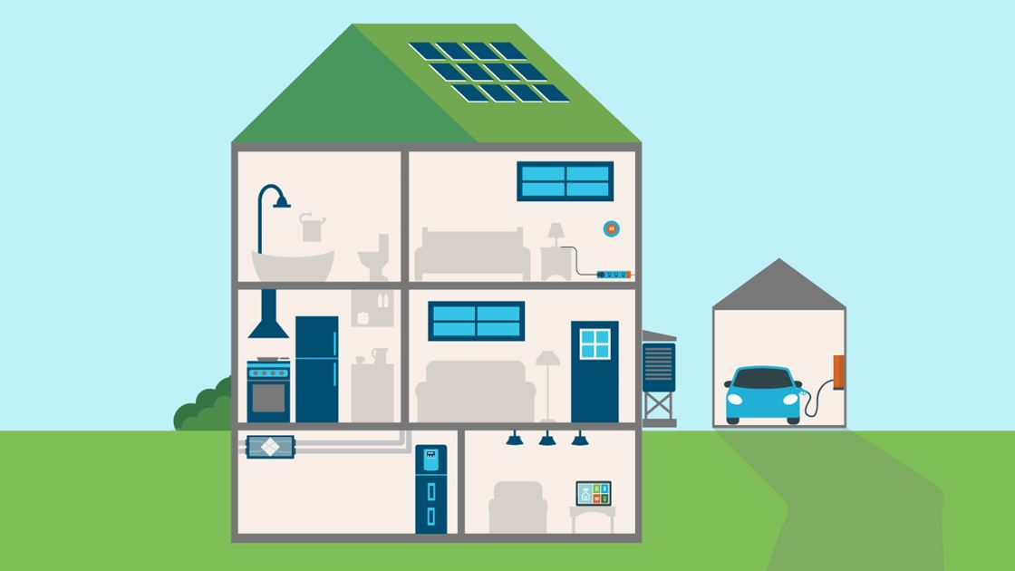
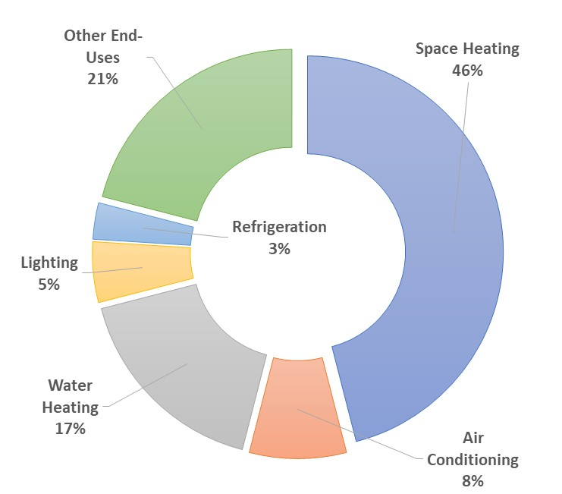
How a Home Uses Energy
Maintain a comfortable & habitable climate
Support occupant’s activities (cooking, food storage, work, recreation, etc.)
Many Sources (Electricity, Natural Gas, Wood, etc.)
* Data from EIA Residential Energy Consumption Survey (2015)
Notes:
Image src: https://www.efficiencyvermont.com/Media/Default/blog/HowTo/EVT-Brand-2021-COVER-IMAGE.jpg?width=1120&quality=80&format=jpg

Slide 14
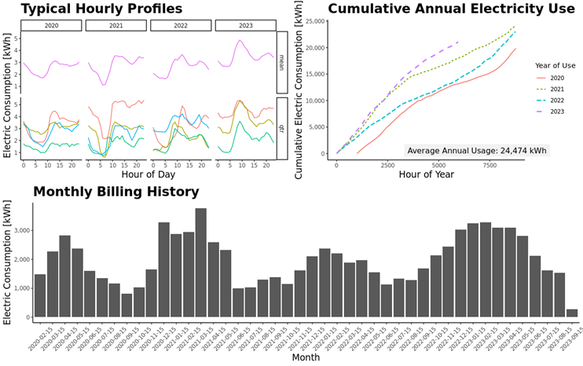
How a Home Uses Energy
Occupant’s decisions are just as important as the ‘widgets’ in the home!
Notes:
Image src: https://www.efficiencyvermont.com/Media/Default/blog/HowTo/EVT-Brand-2021-COVER-IMAGE.jpg?width=1120&quality=80&format=jpg

Slide 15
Survey Results: Overview
Emailed survey sent to residential 9,707 customers
Customers received up to two emails, an initial email and a reminder email.
Received 917 responses (a 9.4% response rate)
Response rates somewhat higher for primary rate customers compared to secondary rate customers (11% and 9% respectively)
Appliance specs & fuel types
Home envelope characteristics
Onsite storage / generation
Awareness of District programs
Electric vehicles

Slide 16

Survey Results: Home Envelopes
Reported Window Types
Weighted average year of construction is 1988
Only 20% remodeled in last 5 years (With majority of remodels targeting single rooms)
Most (89%) of windows are double pane, but that leaves a number of homes with single pane windows.
A large number of homes reported leaks (drafts) coming from windows, doors, and walls.
Homes Reporting Air Leaks

Slide 17

Survey Results: Heating Equipment
Most respondents (71.0%) primarily heat their homes using a central forced-air system
The most common supplemental or secondary heating source for respondents' homes is a fireplace or wood stove (57.7%).
15.2 % of respondents use portable electric heaters as a secondary heat source
Typical Thermostat Set-Points (Heating)
Age Of Customer Heating Equipment
Distribution of Heating Fuel Sources

Slide 18

Survey Results: Cooling Equipment
15% of customers indicated having some form of Air Conditioning for their home.
65% of the air conditioning has been installed within the last 8 years (with 46% installed in the last 3)
Those reporting “Other” cooling stated that they use natural ventilation (windows and fans)
Types of Mechanical Cooling
Age Of Customer Cooling Equipment
* Includes heat-pumps

Slide 19
Survey Results: Water Heating
69% of respondents reported having installed low-flow shower heads in all showers with and additional 11% having installed in a portion of their showers.
The majority of the water heater stock is aging and will likely be replaced over the next decade.
Age of Water Heating Equipment
Types of Water Heating
Water Heating Fuel Sources

Slide 20
Survey Results: Home Appliances
The majority of appliances are EnergyStar certified.
Only 34% of dryers use natural gas and 65% are electric.
20% of respondents reported having more than one refrigerator
Most Cooktops are natural gas
23% of those with electric cook-tops report having induction cook-tops.
Cooking Fuel Sources
Saturations of EnergyStar Appliances

Slide 21
Survey Results: Electrification (Electric Vehicles)
18% of customers reported having one or more electric vehicles
40.8% of respondents who do not currently own an electric vehicle said they had plans to purchase an electric vehicle for their next purchase – 38.5% of these customers thought they would make this purchase within the next two years and 18% indicated that it would be more than 5 years.
Of those with BEVs, 55% reported having Level 2 chargers and 15% indicated not charging at home.
Vehicle Ownership
Plans to Purchase EV as Next Vehicle

Slide 22
Survey Results: Electrification (EVs Cont.)
Driving range, availability of charging stations, and availability of financial incentives for EVs were rated as most significant in decisions to purchase an electric vehicle.
Range anxiety and economic factors such as upfront and ownership costs were the most common reasons for not purchasing an EV. Charging infrastructure was the third most common response.
The top four suggested locations mentioned for the locations of public-access EV charging stations were Tahoe Donner, downtown, recreation areas, and grocery stores.

Slide 23
Survey Results: Electrification (Appliances)
Customer Perspectives on Electric Heat Pumps for Space and Water Heating
The most common concerns stated were service disruptions and fire followed by the ability of their electrical systems or their grid to handle the load.
Only 7.4% of respondents indicated that a monetary incentive would affect their decision to purchase a heat pump water heater.
20% of respondents stated they would consider replacing their cooktop with an induction one (22% would like to learn more about them).
Many stated that gas was a better fuel for cooking, followed by satisfaction with their current equipment.
It is safe
It is reliable
It will reduce my energy bills
Will reduce my carbon footprint
I am interested in converting to electric heat

Slide 24
Takeaways For Public Programs
Provided numeric confirmation of some trends we expected to see:
Traditional energy efficiency measures are highly saturated and no longer need financial incentives (rebates) for market adoption.
Additional energy efficiency opportunities exist in building envelopes, income qualified, in heating and cooking end-uses, and in behavior/education
Electric vehicles are here and continuing to grow!
Gained insight into customer perspectives (and intentions) on electrification:
The main barrier to electrification (aside from cost) is a general anxiety regarding grid reliability in the winter months.
Many customers prefer to cook with gas appliances which they perceive offer a superior result/experience.
Customers seem more open to electrifying their water heating than their space heating
Notes:
LED Lighting Image Src: https://www.lampsplus.com/ideas-and-advice/wp-content/uploads/2020/09/LED_Light_Bulbs_Image-1024x681.jpg
Energy Star Appliances Image Src: https://www.mlecmn.net/sites/default/files/inline-images/Image_Res_Appliances_1.png

Slide 25
Takeaways For Public Programs
Customer Program Design Impacts:
Re-focus general programs on education and behavioral awareness. Examples include:
  Cooking class / induction demonstration in the community
  Expanding energy audit/assessment
  Energy & water use reporting
  Water Efficient gardening classes with community partners
  Partnering with SWEP and developing curriculum for education programs
Reassess cost-effectiveness and free-ridership assumptions for residential “widget” rebates and shift financial incentives towards income qualified customers and areas where we can impact market transformation.
Particular focus on building envelopes, water heating, and space heating
Notes:
LED Lighting Image Src: https://www.lampsplus.com/ideas-and-advice/wp-content/uploads/2020/09/LED_Light_Bulbs_Image-1024x681.jpg
Energy Star Appliances Image Src: https://www.mlecmn.net/sites/default/files/inline-images/Image_Res_Appliances_1.png

Slide 26

Questions?
Notes:
LED Lighting Image Src: https://www.lampsplus.com/ideas-and-advice/wp-content/uploads/2020/09/LED_Light_Bulbs_Image-1024x681.jpg
Energy Star Appliances Image Src: https://www.mlecmn.net/sites/default/files/inline-images/Image_Res_Appliances_1.png

