Slide 1
TDPUD Integrated Resource Plan
Report
Truckee Donner PUD Board Meeting
February 7, 2023

Slide 2
Background
In accordance with the Board’s decision to pursue TDPUD’s first ever IRP, the District issued an RFP and selected a consulting team comprised of Aspen and Flynn RCI to perform the analysis.
IRP Purpose: To evaluate and optimize the District’s portfolio of energy supply resources, including energy efficiency and demand response, to meet customer electric needs while balancing various critical, but sometimes competing objectives.
Objectives
  System reliability
  Fiscal responsibility
  Environmental stewardship
  Regulatory compliance

Slide 3


Scope of Work for the Integrated Resource Plan (IRP)
Load Forecast: Prepare a load forecast for each Planning Period to determine the electric energy and capacity requirements of the District as a whole.
Power Contract Review: Review all existing power supply contracts. Indicate when those contracts will need to be renewed and/or that may be approaching end of life.
Resource Utilization Plan: Identify the utilization of resources and types of resources selected to meet future needs and other factors of interest to permit an understanding of the potential future resource needs.
Sensitivity Analysis: Recommend sensitivities to be examined in final model(s), including load growth due to electrification and EV charging, resource cost, reliability, and market volatility.

Slide 4
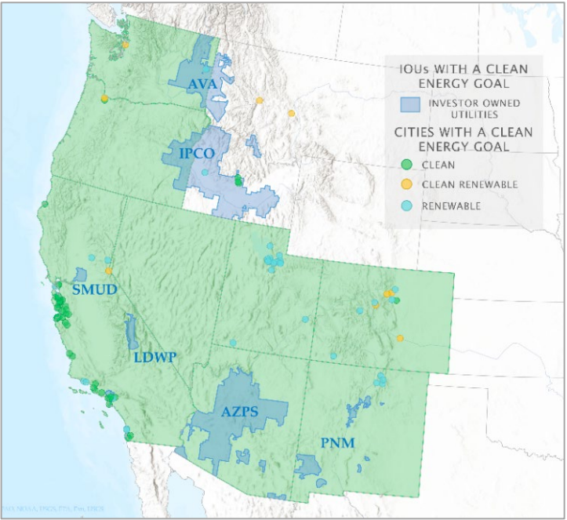

Market Conditions
Increasing competition for limited supply. Key drivers:
  Accelerated load growth (electrification and data centers)
  Increasing desire for clean resources
  Limited near-term availability of resources in the West
  Delays in permitting and constructing resources
  Resource retirements in the next 10 years (~27 GW)
  WECC-wide concern about resource sufficiency to meet extreme events
TDPUD benefits from connection to NV Energy
  Access to lower cost transmission
  Access to Energy Imbalance Market (EIM) that continues to expand
  Renewed interest in a western Regional Transmission Organization (RTO) that may or may not subsume CAISO

Slide 5
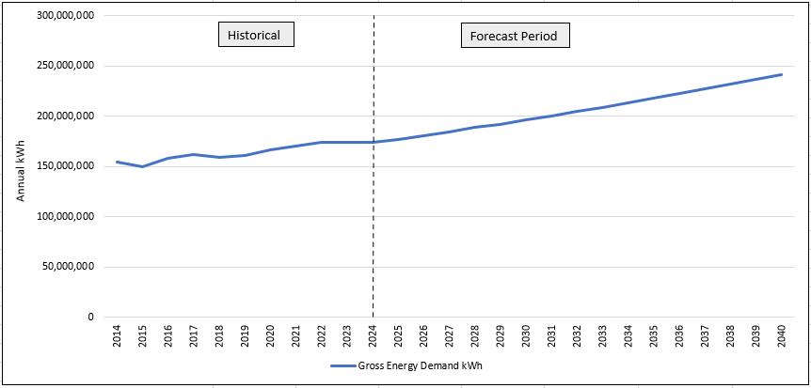
Developing the Load Forecast
Baseline forecast: annual trend of 2.1% growth per year consistent with the last ten years
Model hourly, daily, and monthly load
Modify baseline load with the following:
  EV load (residential and public charging stations)
  Residential and Commercial Rooftop PV generation
  EE, Electrification
Baseline Energy Forecast
*Before Load Modifiers

Slide 6
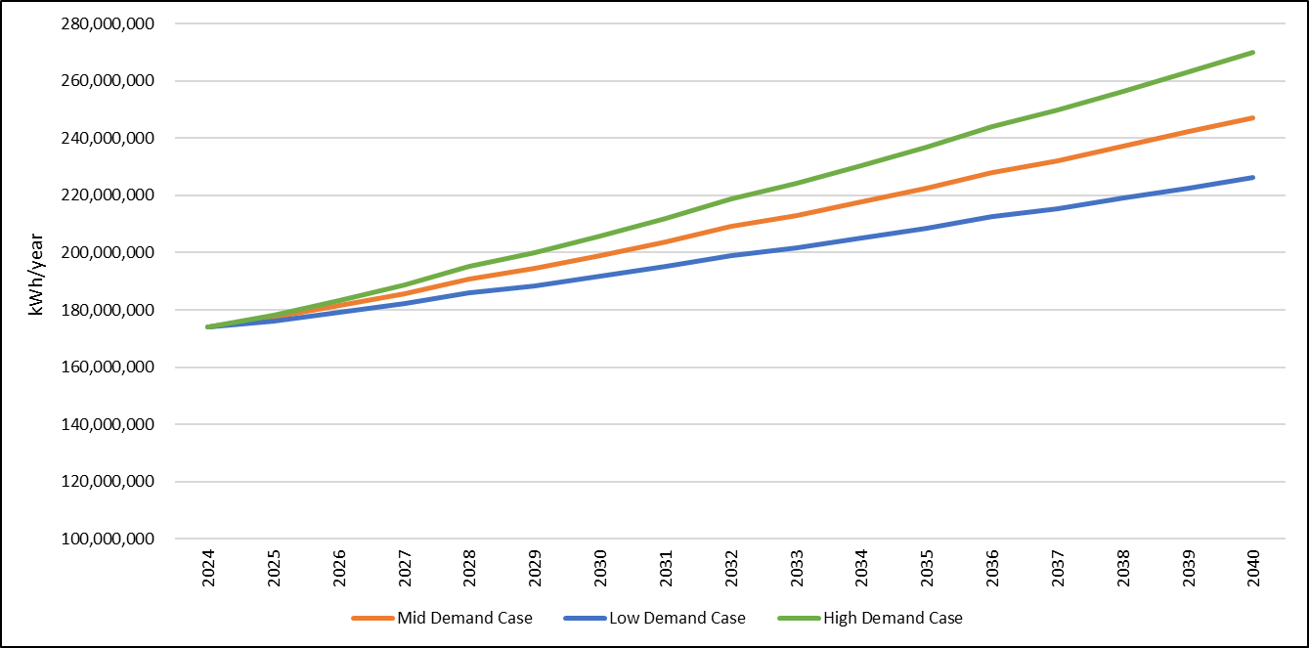
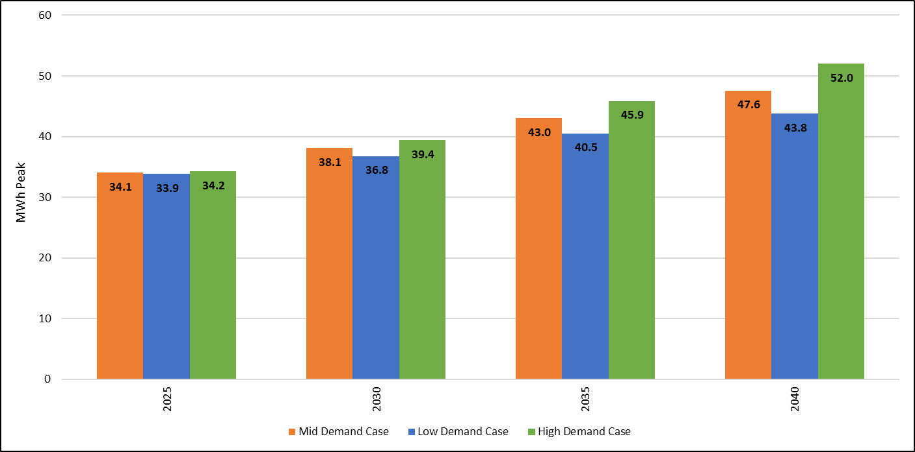
Defining Load Forecast Scenarios
Three cases: Mid, Low and High sensitivity scenarios
Load modifier assumptions vary by sensitivity
Load modifiers influence the total load requirement and the hourly peak load requirement

Slide 7
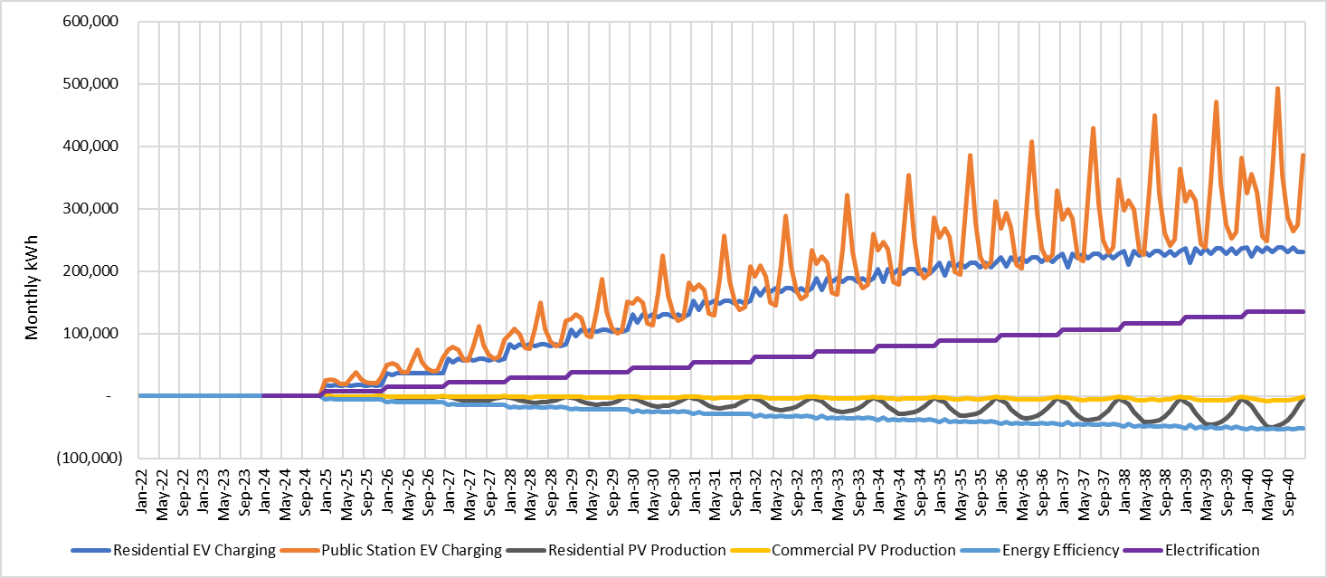
Mid Case Load Modifier Results by Month

Slide 8
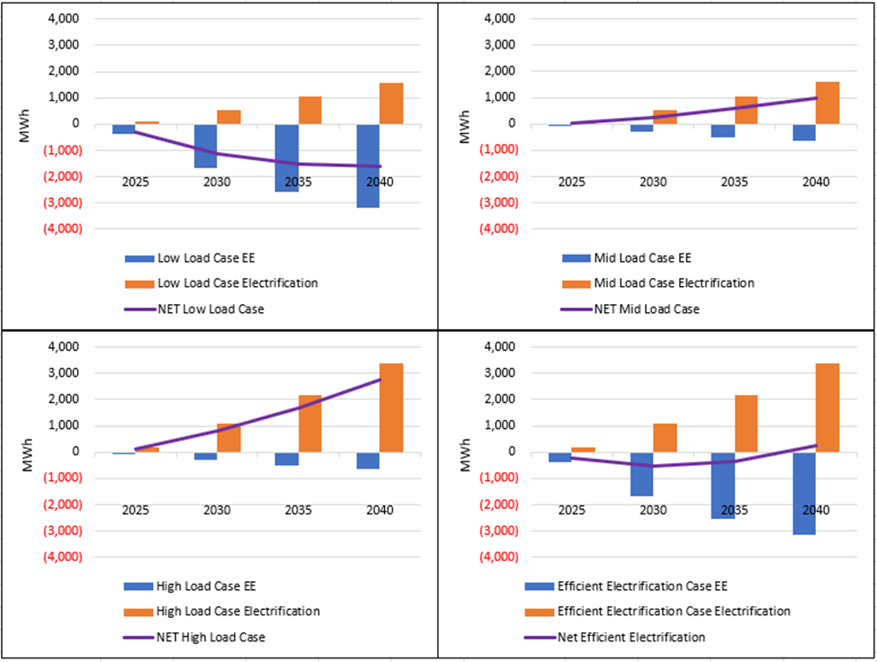
Revisiting Energy Efficiency and Electrification
Developed four EE and Electrification Scenarios
  Low Case Load - Includes potential EE savings and medium electrification
  Mid Case Load – Business as usual (historical) EE savings and medium electrification
  High Case Load – Business as usual (historical) EE savings and accelerated electrification
  (Bonus) Efficient Electrification Case – Potential EE savings and accelerated electrification. Results in high GHG savings.
$/kWh cost for EE varies by scenario assuming savings from new programs capturing potential savings vs. diminishing returns from traditional EE programs (ex. Lighting).
The upshot – Electrification will drive load growth and increased procurement if not paired with EE
EE and Electrification Scenarios (MWh)

Slide 9
IRP Model Features
Excel spreadsheet-based model to track portfolio performance and cost
Generation and load data aggregated to monthly and annual levels, with representative hourly profiles to test supply/demand balance
Track key elements/requirements/constraints
  RPS goals
  GHG-free energy goals
  Resource Adequacy (RA) requirements
  Power Purchase Agreement (PPA) Price/Cost
Sensitivities
  Hydro conditions
  Loads
  Natural Gas/Energy Market Prices
  PPA Price
  5-Year Market Purchase Price
  Resource Adequacy Counting
  Transmission Cost
Notes:
A potential west-wide RTO is not considered.

Slide 10
TDPUD Existing Power Supply Resources
Resource | Owner | TDPUD Share (MW) | Notes
Horse Butte Wind Phase I | UAMPS | 15
Pleasant Valley Wind | UAMPS | 0.25
Trans-Jordan Landfill Gas | UAMPS | 3.2 | Expires in 2024
Nebo Natural Gas | UAMPS | 5
Veyo Waste Heat Recovery | UAMPS | 1.7
Red Mesa Solar | UAMPS | 6
5-Year Market Purchase | UAMPS | 4 | Expires in 2027
Stampede Powerplant | WAPA | 4 | Expires in 2024*
26 Foot Drop Hydro | TCID | 1 | Expires in 2023*
Old Lahontan Hydroelectric | TCID | 2.7 | Expires in 2023*
Central Valley Project | WAPA | 2 | Available in 2025
Spot Market Purchase | UAMPS | No limit
RPS Eligible
Neither GHG-Free, nor RPS eligible
GHG-Free, but not RPS eligible
* Assumed to be renewed

Slide 11
TDPUD Future Power Supply Resource Possibilities
Resource | Owner | TDPUD Share (MW) | Earliest Year Available
Horse Butte Wind Phase II | UAMPS | 11 | 2026
Geothermal Project X | TBD | 2.45 | 2027
4 Hour Solar Plus Storage Resource - Solar | TBD | 6 | 2027
4 Hour Solar Plus Storage Resource - Storage | TBD | 3 - 7 | 2027
8 Hour Solar Plus Storage Resource - Solar | TBD | 4 | 2027
8 Hour Solar Plus Storage Resource - Storage | TBD | 2 | 2027
Additional Geothermal Project | N/A | 4.5 - 12.5 | 2035
New Lahontan Hydroelectric | TCID | 4 | 2025
Community Solar | TDPUD | 1 - 12 | 2027
4 Hour TDPUD BESS | TBD | 1 - 4 | 2027
New 5-Year Market Purchase | UAMPS | 4 | 2027
RPS Eligible
GHG-Free, but not RPS eligible
Neither GHG-Free, nor RPS eligible
Notes:
Describe why we have so many resources with little capacity…considering that so many LSEs are competing for similar resources.
To make clear this is nuclear, but when you do so you want to make clear this is not like Diablo. This is a new design, small in scale, no big cooling towers, manufacturing done remotely.

Slide 12
Overview of IRP Methodology
Examine Planning Framework and Risks
Assess Needs
Consider Resource Options
Develop Resource Portfolios
Perform Scenario and Risk Analysis
Identify Recommended Portfolio
Notes:
Examine Planning Framework and Risks: Identify and assess challenges the utility faces in the current business and regulatory environment.
Assess Needs: Develop forecasts of load changes (incorporating impacts of cost-effective demand-side resources), existing contracts, contract terms, and operational constraints to determine resource needs over the planning period.
Consider Resource Options: Evaluate available generation resources, including centralized and distributed renewables and long-term market power purchases, to identify the role each will play in meeting customer needs and regulatory and policy goals.
Develop Resource Portfolios: Develop resource portfolios, and evaluate them quantitatively and qualitatively to determine a preferred portfolio. Evaluation relies upon RPS and GHG-free requirements, needs assessment, and planning data specified in previous steps.
Perform Scenario and Risk Analysis: Perform detailed evaluations of preferred resource portfolios through scenario and risk analysis to assess performance under a range of potential market and regulatory conditions.
Identify Recommended Portfolio: Identify a “Recommended Portfolio” based on the resource portfolio expected to reliably serve demand at a reasonable long-term cost, while achieving regulatory compliance, accounting for inherent risks, and allowing for flexibility to respond to future policy changes.

Slide 13
Recommended Resource Portfolio
Notes:
By applying the six (6) steps described in the IRP Methodology, we developed the recommended resource portfolio.
In order to develop the resource portfolios, we applied the following screens.
Is it reliable in terms of maintaining planning reserve margin, given preconditions for market participation and transmission provider requirements?
Does it minimize the overall cost of procurement, and manage market volatility, enabling the District to offer competitive rates?
Does it comply with the State’s environmental goals and policies?
Does it comply with the District's goals?
Does it include resource diversity?
Does the portfolio adequately balance resources against loads on an hourly basis.
How does it perform under a range of sensitivities?
We also considered the tradeoff between the remote utility-scale generation and within-district resource development, such as Community Solar and TDPUD 4-hour storage.

Slide 14
TDPUD’s Electric Supply Mix Under Recommended Portfolio
The Recommended Portfolio meets the Resource Diversity goal with a mix of intermittent solar, wind and hydro resources, and firm battery storage, geothermal, and hydro resources.
Notes:
The Recommended portfolio shows increased reliance on renewable resources, such as geothermal and solar resources, while reducing the District’s reliance on natural-gas-fired resources. The significant increase in contracted resources helps the District transition from being a net buyer in the spot market in the early years (2025) to a net seller in the later years.

Slide 15
Recommended Portfolio RPS and GHG-Free Levels vs. Requirements
The Recommended Portfolio meets the State policy goals by relying primarily on the renewables that meet the RPS goals (Top Figure) and other GHG-free resources that count towards meeting the GHG goals (Bottom Figure).
Notes:
Figure shows that the Recommended portfolio is compliant for the four distinct years in meeting the State RPS and GHG-free requirements. It also confirms that this compliance holds for the entire planning period. That is, the Recommended portfolio meets the State policy goals by relying primarily on renewable resources that meet the RPS requirements (Top Figure) and other GHG-free resources that count towards meeting the GHG-free goals (Bottom Figure).

Slide 16
Recommended Portfolio Seasonal Supply Stack :
December vs. August 2040
The Recommended Portfolio balances resources against loads reasonably well, typically being short only in the late evening hours in December (Top Figure) and Excess for non-evening hours in August (Bottom Figure).
Notes:
Figure indicates that during the winter months, wind, battery storage, natural gas-fired generation, and spot market purchases play a key role in serving the evening ramps. In contrast, in August, very little natural gas-fired generation is needed to serve the District loads, and the District will be mostly making spot market and REC sales. Battery storage typically charges during the early and late morning hours and discharges during the late evening hours when the net load (load net of solar generation) is the highest during the day.

Slide 17
Recommended Portfolio Performs Well Relative to Alternative Portfolio
Recommended portfolio is slightly less cost-effective than alternative portfolio with no storage and high geothermal. However, TDPUD’s ability to contract high levels of geothermal is uncertain, and losing storage paired with solar would increase congestion exposure. The No New PPA (NNP) portfolio is the least cost-effective. Geothermal is key in managing costs while meeting the RA and GHG goals.
Scope and Cost (M$) Performance of Recommended Portfolio Relative to Alternative Portfolios: Net Present Value of Cost (Value) Over 17 Years at 5% Discount Factor

Slide 18
Recommended Portfolio Performs Well Relative to Alternative Portfolio Reliability and Environmental Criteria
Recommended Portfolio
The recommended portfolio is reliable (PRM >= 115%) in all years (though short-term contracted RA resources will be needed in 2025) and meets all the required State RPS and GHG-free goals.
No New PPA (NNP) Portfolio
The NNP portfolio does not meet reliability target in any years (i.e., PRM < 115%) and does not meet the State RPS (except in 2025) or GHG-free goals.
* Requires additional RA capacity purchase to meet 115% PRM
** Requires additional REC purchase to meet RPS goals of 60% beyond 2030. The GHG-free goals of 90% by 2035 and 95% by 2040 are not met by the NNP portfolio.
Notes:
The recommended portfolio performs fairly well even under the High Demand sensitivity, except for meeting the reliability (PRM) goal in 2040. the message there is that if the TDPUD is on a high demand trajectory, it may need to make a decision to procure more firm resources post-2035.
Other alternative portfolios are also designed to meet the all the required State RPS and GHG-free goals.

Slide 19
The Recommended Portfolio Performs Well Under Uncertainty
Portfolio costs are most sensitive to the load assumptions.
NVE transmission charges have some impact on costs, but only local resources can avoid the charges and limitations on the amount of such resources make this a less important decision factor
The PPA price, NG/Energy Market Price, and RA uncertainties have moderate cost impacts
All other uncertainties are insignificant
Notes:
We also developed a range of sensitivity values for key variables, such as Hydro conditions, Loads, Natural Gas/Energy Market prices, PPA price, 5-year Market Purchase price, Resource Adequacy Counting, etc. that could affect the performance of the alternative portfolios consistent with the IRP methodology step 5. In this table, we summarize the changes to the key variables used in the sensitivity analysis. For example, the geothermal PPA price is assumed to be 25% higher in the High scenario relative to the Base scenario, whereas the Solar PPA prices are assumed to be 8% lower and 15% higher relative to the Base scenario in the Low and High scenarios, respectively. Early Hydro sensitivity changes the hydro condition pattern compared to the Base scenario. The Low Early Hydro scenario assumes all three early years to be wet, driving the overall cost of procurement down. In contrast, the High Early Hydro scenario assumes all three early years to be dry, which drives up the overall cost of procurement relative to the Base scenario.
We stress-tested the performance of the Recommended portfolio using the extreme ranges of each sensitivity parameter, changing one variable at a time, as shown in a tornado diagram in this figure. Various combinations of these sensitivities can be developed to create additional scenarios to further test the robustness of the alternative portfolios, though for simplicity, the IRP study has concentrated on evaluating Portfolio performance with single sensitivity parameter changes.
In the Recommended portfolio costs are most sensitive to changes in the load assumptions. Under the high load forecast, the portfolio cost increased by approximately $12 million to a total of $213 million NPV. This portfolio is also sensitive to the PPA price, especially on the higher side, given the large portion of PPA contracted resources in this portfolio. NVE transmission charges have some impact on costs, but only local resources (community solar and TDPUD 4-hour storage) can avoid these charges, and limitations on the amount of such resources make this a less important decision factor. The NG/Energy Market price, and RA uncertainties have only moderate cost impacts as this portfolio hedges those risks via significant long-term contracting. All other uncertainties are insignificant. Overall, the Recommended portfolio performs very well under uncertainty.

Slide 20
In Summary, the Recommended Portfolio Meets the Desired Criteria
It is reliable in terms of maintaining planning reserve margin.
It has the lowest overall cost of procurement, and reduces exposure to market volatility.
It complies with the State’s environmental goals and policies.
It includes resource diversity.
It is a good fit in terms of balancing resources against loads.
It performs well under a range of sensitivities.
Notes:
Overall, the Recommended portfolio meets all projected demand and is reliable in terms of maintaining planning reserve margin. It has one of the lowest overall cost of procurement, and reduces exposure to market volatility. It complies with the State’s environmental goals and policies. It includes required resource diversity and is a good fit in terms of balancing resources against loads. We have also tested that the Recommended portfolio performs well under a range of sensitivities. We recommend that the District explore the potential for increasing the proportion of geothermal or other baseload resources into the Recommended portfolio, with a corresponding decrease in reliance on solar plus storage, since this potentially could result in lower overall costs, while also increasing resource diversity.

Slide 21
Concluding Remarks
Demand before modifiers, grows at 2.1%; with modifiers 1.7 to 2.8%
TDPUD continues to be a winter peaking utility
The District should continue to invest in energy efficiency, looking for new programs to assure that electrified load is efficient
TDPUD is resource adequate in short-term but will not be as existing supply contracts expire
The District faces competition chasing the same supplies as others
The recommended portfolio achieves resource adequacy
  Meets clean targets at a reasonable NPV compared to alternatives
  Supplements TDPUD’s existing resources with a diverse mix of geothermal (and other baseload resources) and solar plus storage resources
With the IRP in hand, the District has an opportunity to modify its supply portfolio, recognizing projected demand, available resources, and market conditions

Slide 22
Recommendation
Receive this information workshop and provide input and direction to staff.

Slide 23
Appendix

Slide 24
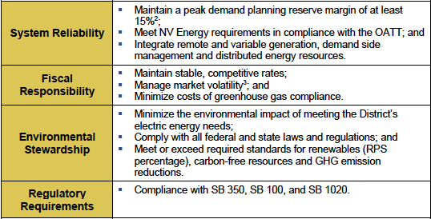
Governing Objectives for District IRP
Notes:
The Clean Energy and Pollution Reduction Act (Senate Bill 350) established clean energy, clean air, and greenhouse gas (GHG) reduction goals, including reducing GHG to 40 percent below 1990 levels by 2030 and to 80 percent below 1990 levels by 2050.
Senate Bill (SB) 100 requires that all retail electricity sold must come from renewable resources and zero-carbon resources by 2045. SB100 also updates California's Renewables Portfolio Standard, requiring renewables to provide at least 60 percent of the state's electricity by 2030.
SB 1020 adds interim targets to the policy framework originally established in SB 100 (DeLeón, Chapter 312, Statutes of 2018) to require renewable energy and zero-carbon resources to supply 90% of all retail electricity sales by 2035 and 95% of all retail electricity sales by 2040.

Slide 25
Hydro Production Projections and Sensitivities
Notes:
Flynn RCI used data for Northern CA hydro generation for the last 104 years- 1920-2023 to develop distributions of dry, median, and wet hydro conditions. The probabilities of occurrence of these hydro conditions were used to randomly assign them to the planning period of 2024-2040 as shown in the table. Early Hydro sensitivity changes the hydro condition pattern compared to the Base scenario. The Low Early Hydro scenario assumes all three early years to be wet, driving the overall cost of procurement down. In contrast, the High Early Hydro scenario assumes all three early years to be dry, which drives up the overall cost of procurement relative to the Base scenario.

Slide 26
TDPUD’s Changing Resource Mix -- Recommended Portfolio: 2025-2040
Recommended Portfolio relies primarily on resources (green) to meet the RPS goals, supplemented by other GHG-free resources (blue) that count towards meeting GHG goals and enhance reliability.
Notes:
Horse Butte Wind Phase II 2026 11.05
Geothermal Resource 2027 2.45
4 Hour Solar Plus Storage Resource - Solar 2027 6.00
4 Hour Solar Plus Storage Resource – Storage 2027 3
8 Hour Solar Plus Storage Resource - Solar 2027 6.00
8 Hour Solar Plus Storage Resource – Storage 2027 3.00
Additional Geothermal Projects 2035 7.50
New Lahontan Hydroelectric 2025 4.00
Community Solar 2027 2.00
4 Hour TDPUD Storage 2026 1.00
New Market Purchase Contract 2028 4.00

Slide 27
Sensitivities Considered
Notes:
We also developed a range of sensitivity values for key variables, such as Hydro conditions, Loads, Natural Gas/Energy Market prices, PPA price, 5-year Market Purchase price, Resource Adequacy Counting, etc. that could affect the performance of the alternative portfolios consistent with the IRP methodology step 5. In this table, we summarize the changes to the key variables used in the sensitivity analysis. For example, the geothermal PPA price is assumed to be 25% higher in the High scenario relative to the Base scenario, whereas the Solar PPA prices are assumed to be 8% lower and 15% higher relative to the Base scenario in the Low and High scenarios, respectively. Early Hydro sensitivity changes the hydro condition pattern compared to the Base scenario. The Low Early Hydro scenario assumes all three early years to be wet, driving the overall cost of procurement down. In contrast, the High Early Hydro scenario assumes all three early years to be dry, which drives up the overall cost of procurement relative to the Base scenario.

Slide 28
The No New PPA (NNP) Portfolio Performs Poorly Under Uncertainty
The expected cost of NNP is significantly higher than the Recommended Portfolio.
It is even costlier if the loads are higher than anticipated
NG/Energy Marker Price volatility is extremely high due to high reliance on the market price purchases.
NVE transmission charges have some impact on costs, but only local resources can avoid the charges and limitations on the amount of such resources make this a less important decision factor.
The PPA price has no cost impact as no new resources are being procured
Notes:
On the other hand, the NNP portfolio performs very poorly, and has a higher exposure to uncertainty, as shown in the Figure. The expected cost of NNP of $229.0 million NPV is significantly higher than the Recommended Portfolio. It is even costlier at $257 million, if the loads are higher than anticipated. The NG/Energy Marker Price volatility is extremely high for the NNP portfolio due to high reliance on the market price purchases. The PPA price has no impact on cost uncertainty as no new resources are being procured.

Slide 29
Estimating Load Modifiers
Residential EV Charging:
  Apply Bass Diffusion curve for EV stock adoption and market share projection
  Develop forecasted hourly charging profile from NREL’s EVI-Pro Lite tool
  Multiply EV stock by charging forecast to generate future residential charging load
Public EV Charging:
  Combines TDPUD hourly charging data and trip projections from the Truckee-Tahoe EV Readiness Report to forecast public charging load
Residential/commercial PV (residential 0.49% 2022 total retail sales – 263 customers)
  TDPUD hourly AMI data for residential and commercial solar customers used for monthly generation profiles and forecasting generation
  Only 50 permit applications – new construction getting snow load or shading exemptions
Energy Efficiency
  Mid case applies TDPUD historical savings
  Low demand case captures additional potential savings
Electrification – TDPUD Electrification Survey

Slide 30
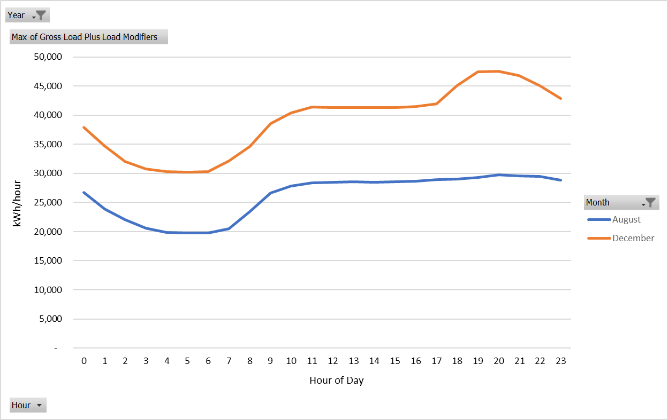
Mid Case Load Forecast – Hourly
Peak load and hourly load shape for comparison against the supply portfolio
Load modifiers influence the hourly load shape
TD continues to be a winter-peaking utility in all scenarios
2040

Slide 31
Additional Exploratory Scenarios

